Slide 1
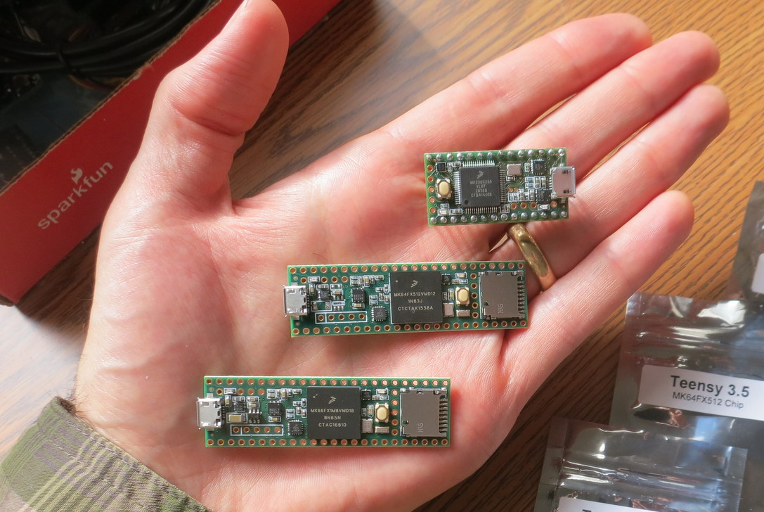
New and Faster
Teensies!
3.2
3.5
NEW
NEW
3.6

Slide 2
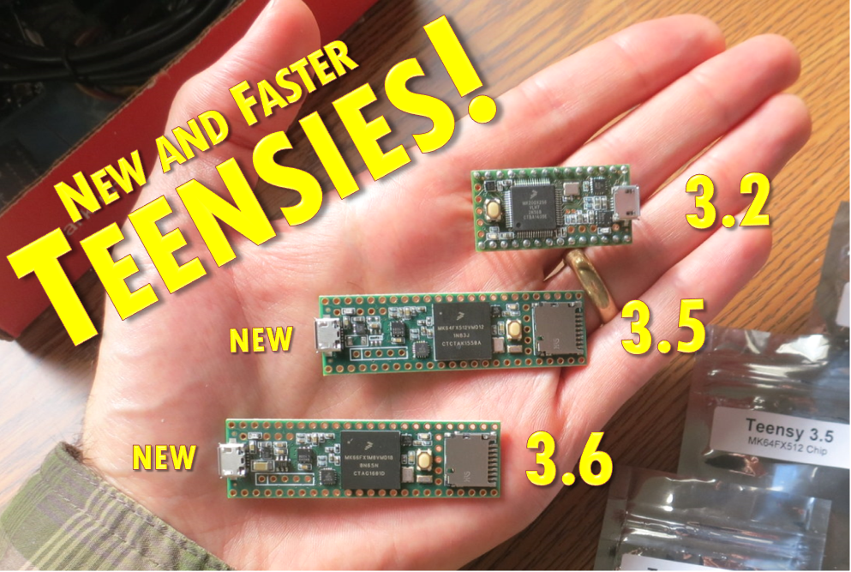

Slide 3
Board |  | Microcontroller
Brand | Model | Brand | Model | Core | Clock | Width | FPU | RAM
Arduino | Uno | Atmel | MEGA328P | AVR | 16 MHz | 8-bit | No | 2 KB
Arduino | M0 PRO | Atmel | SAMD21G18 | ARM Cortex-M0+ | 48 MHz | 32-bit | No | 32 KB
PJRC | Teensy 3.2 | NXP | MK20DX256 | ARM Cortex-M4 | 96 MHz | 32-bit | No | 64 KB
PJRC | Teensy 3.5 | NXP | MK64FX512 | ARM Cortex-M4 | 120 MHz | 32-bit | Yes | 192 KB
PJRC | Teensy 3.6 | NXP | MK66FX1M0 | ARM Cortex-M4 | 180 MHz | 32-bit | Yes | 256 KB
NXP | FRDM-K66F | NXP | MK66FN2M0 | ARM Cortex-M4F | 180 MHz | 32-bit | Yes | 256 KB
Board |  | Microcontroller
Brand | Model | Brand | Model | Core | Clock | Width | FPU | RAM
Arduino | Uno | Atmel | MEGA328P | AVR | 16 MHz | 8-bit | No | 2 KB
Arduino | M0 PRO | Atmel | SAMD21G18 | ARM Cortex-M0+ | 48 MHz | 32-bit | No | 32 KB
LeafLabs | Maple | STM | STM32F103 | ARM Cortex-M3 | 72 MHz | 32-bit | No | 20 KB
Arduino | Due | Atmel | SAM3X8E | ARM Cortex-M3 | 84 MHz | 32-bit | No | 96 KB
PJRC | Teensy 3.2 | NXP | MK20DX256 | ARM Cortex-M4 | 96 MHz | 32-bit | No | 64 KB
PJRC | Teensy 3.5 | NXP | MK64FX512 | ARM Cortex-M4 | 120 MHz | 32-bit | Yes | 192 KB
PJRC | Teensy 3.6 | NXP | MK66FX1M0 | ARM Cortex-M4 | 180 MHz | 32-bit | Yes | 256 KB
NXP | FRDM-K66F | NXP | MK66FN2M0 | ARM Cortex-M4F | 180 MHz | 32-bit | Yes | 256 KB

Slide 4
 |  | FFTs Per Second (More Is Faster)
Inputs |  | Generic C FFT |  | CMSIS FFT
N | Data | Arduino Uno | Arduino M0 | Teensy 3.2 | Teensy 3.5 | Teensy 3.6 | FRDM-K66F
32 | Int16 | 201 | 3,127 | 30,864 | 40,783 | 74,405 | 58,824
64 | Int16 | 99 | 1,594 | 16,529 | 21,636 | 37,622 | 33,333
128 | Int16 | * | 639 | 7,156 | 9,306 | 16,171 | 14,286
256 | Int16 | * | 325 | 3,669 | 4,756 | 7,992 | 7,353
512 | Int16 | * | 135 | 1,575 | 2,070 | 3,449 | 3,226
 |  | FFTs Per Second (More Is Faster)
Inputs |  | Generic C FFT |  | CMSIS FFT
N | Data | Arduino Uno | Arduino M0 | Teensy 3.2 | Teensy 3.5 | Teensy 3.6 | FRDM-K66F
32 | Int32 | 80 | 1,247 | 16,474 | 21,496 | 37,010 | 31,250
64 | Int32 | * | 597 | 8,578 | 11,141 | 18,491 | 16,667
128 | Int32 | * | 236 | 3,293 | 4,329 | 7,326 | 6,211
256 | Int32 | * | 114 | 1,675 | 2,198 | 3,620 | 3,155
512 | Int32 | * | 47 | 677 | 901 | 1,497 | 1,272
 |  | FFTs Per Second (More Is Faster)
Inputs |  | Generic C FFT |  | CMSIS FFT
N | Data | Arduino Uno | Arduino M0 | Teensy 3.2 | Teensy 3.5 | Teensy 3.6 | FRDM-K66F
32 | Float32 | 157 | 457 | 3,542 | 30,979 | 48,733 | 40,000
64 | Float32 | * | 199 | 1,811 | 16,529 | 24,888 | 21,277
128 | Float32 | * | 81 | 658 | 6,833 | 10,531 | 9,524
256 | Float32 | * | 37 | 331 | 3,524 | 5,239 | 4,878
512 | Float32 | * | 16 | 130 | 1,477 | 2,281 | 2,123
* Insufficient RAM

Slide 5
Speed Relative to Teensy 3.2 (128-pt CMSIS FFT)
 | Teensy 3.2 | Teensy 3.5 | Teensy 3.6
Int16 | 1.00 | 1.30 | 2.26
Int32 | 1.00 | 1.31 | 2.22
Float32 | 1.00 | 10.39 | 16.01
Clock Speed | 1.00 | 1.25 | 1.88

Slide 6
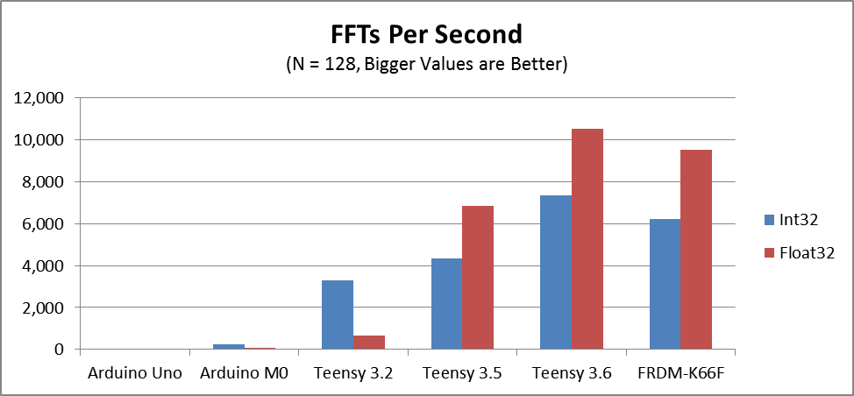

Slide 7
 |  | Max Sample Rate (Hz) for FFT+IFFT with 50% Overlap (Bigger is Better)
Inputs |  | Generic C FFT |  | CMSIS FFT
N | Data | Arduino Uno | Arduino M0 | Teensy 3.2 | Teensy 3.5 | Teensy 3.6 | FRDM-K66F
128 | Int16 | * | 20,447 | 228,997 | 297,785 | 517,464 | 457,143
128 | Int32 | * | 7,545 | 105,367 | 138,528 | 234,432 | 198,758
128 | Float32 | * | 2,599 | 21,042 | 218,669 | 336,984 | 304,762
* Insufficient RAM

